Slide 1

Gene List Analysis Report
Hint: Each slide has notes that explain the analysis!
http://metascape.org
Please cite Zhou et al. Nature Commun. 2019 10(1):1523
Jul 3, 2022
Notes:
This analysis report is automatically generated by Metascape (https://metascape.org).

Slide 2
Gene List Summary
Name | Total | Unique | _Color_
CNet-SVM | 32 | 32 | #E41A1C
Enet-SVM | 7 | 7 | #377EB8
L2SCAD-SVM | 20 | 20 | #4DAF4A
Lasso-SVM | 9 | 9 | #984EA3
SCAD-SVM | 12 | 12 | #FF7F00
SGLasso-SVM | 28 | 28 | #FFFF33
SVM-RFE | 30 | 30 | #A65628
mRMR-SVM | 30 | 30 | #F781BF
Please check online Metascape User Manual for explanation of each annotation field.
Notes:
Metascape first automatically converts you input identifiers (Entrez Gene ID, RefSeq, Ensembl ID, UnProt ID or Symbol) into Human Entrez Gene ID. For example, input identifiers can be from human, mouse or rat orthologs, which can be mapped into human (or “analysis as” species) based on both EggNOG and Homologene databases.
The background of each row is the color code used in the various plots within this report, where each color is consistently used to code a corresponding gene list.

Slide 3
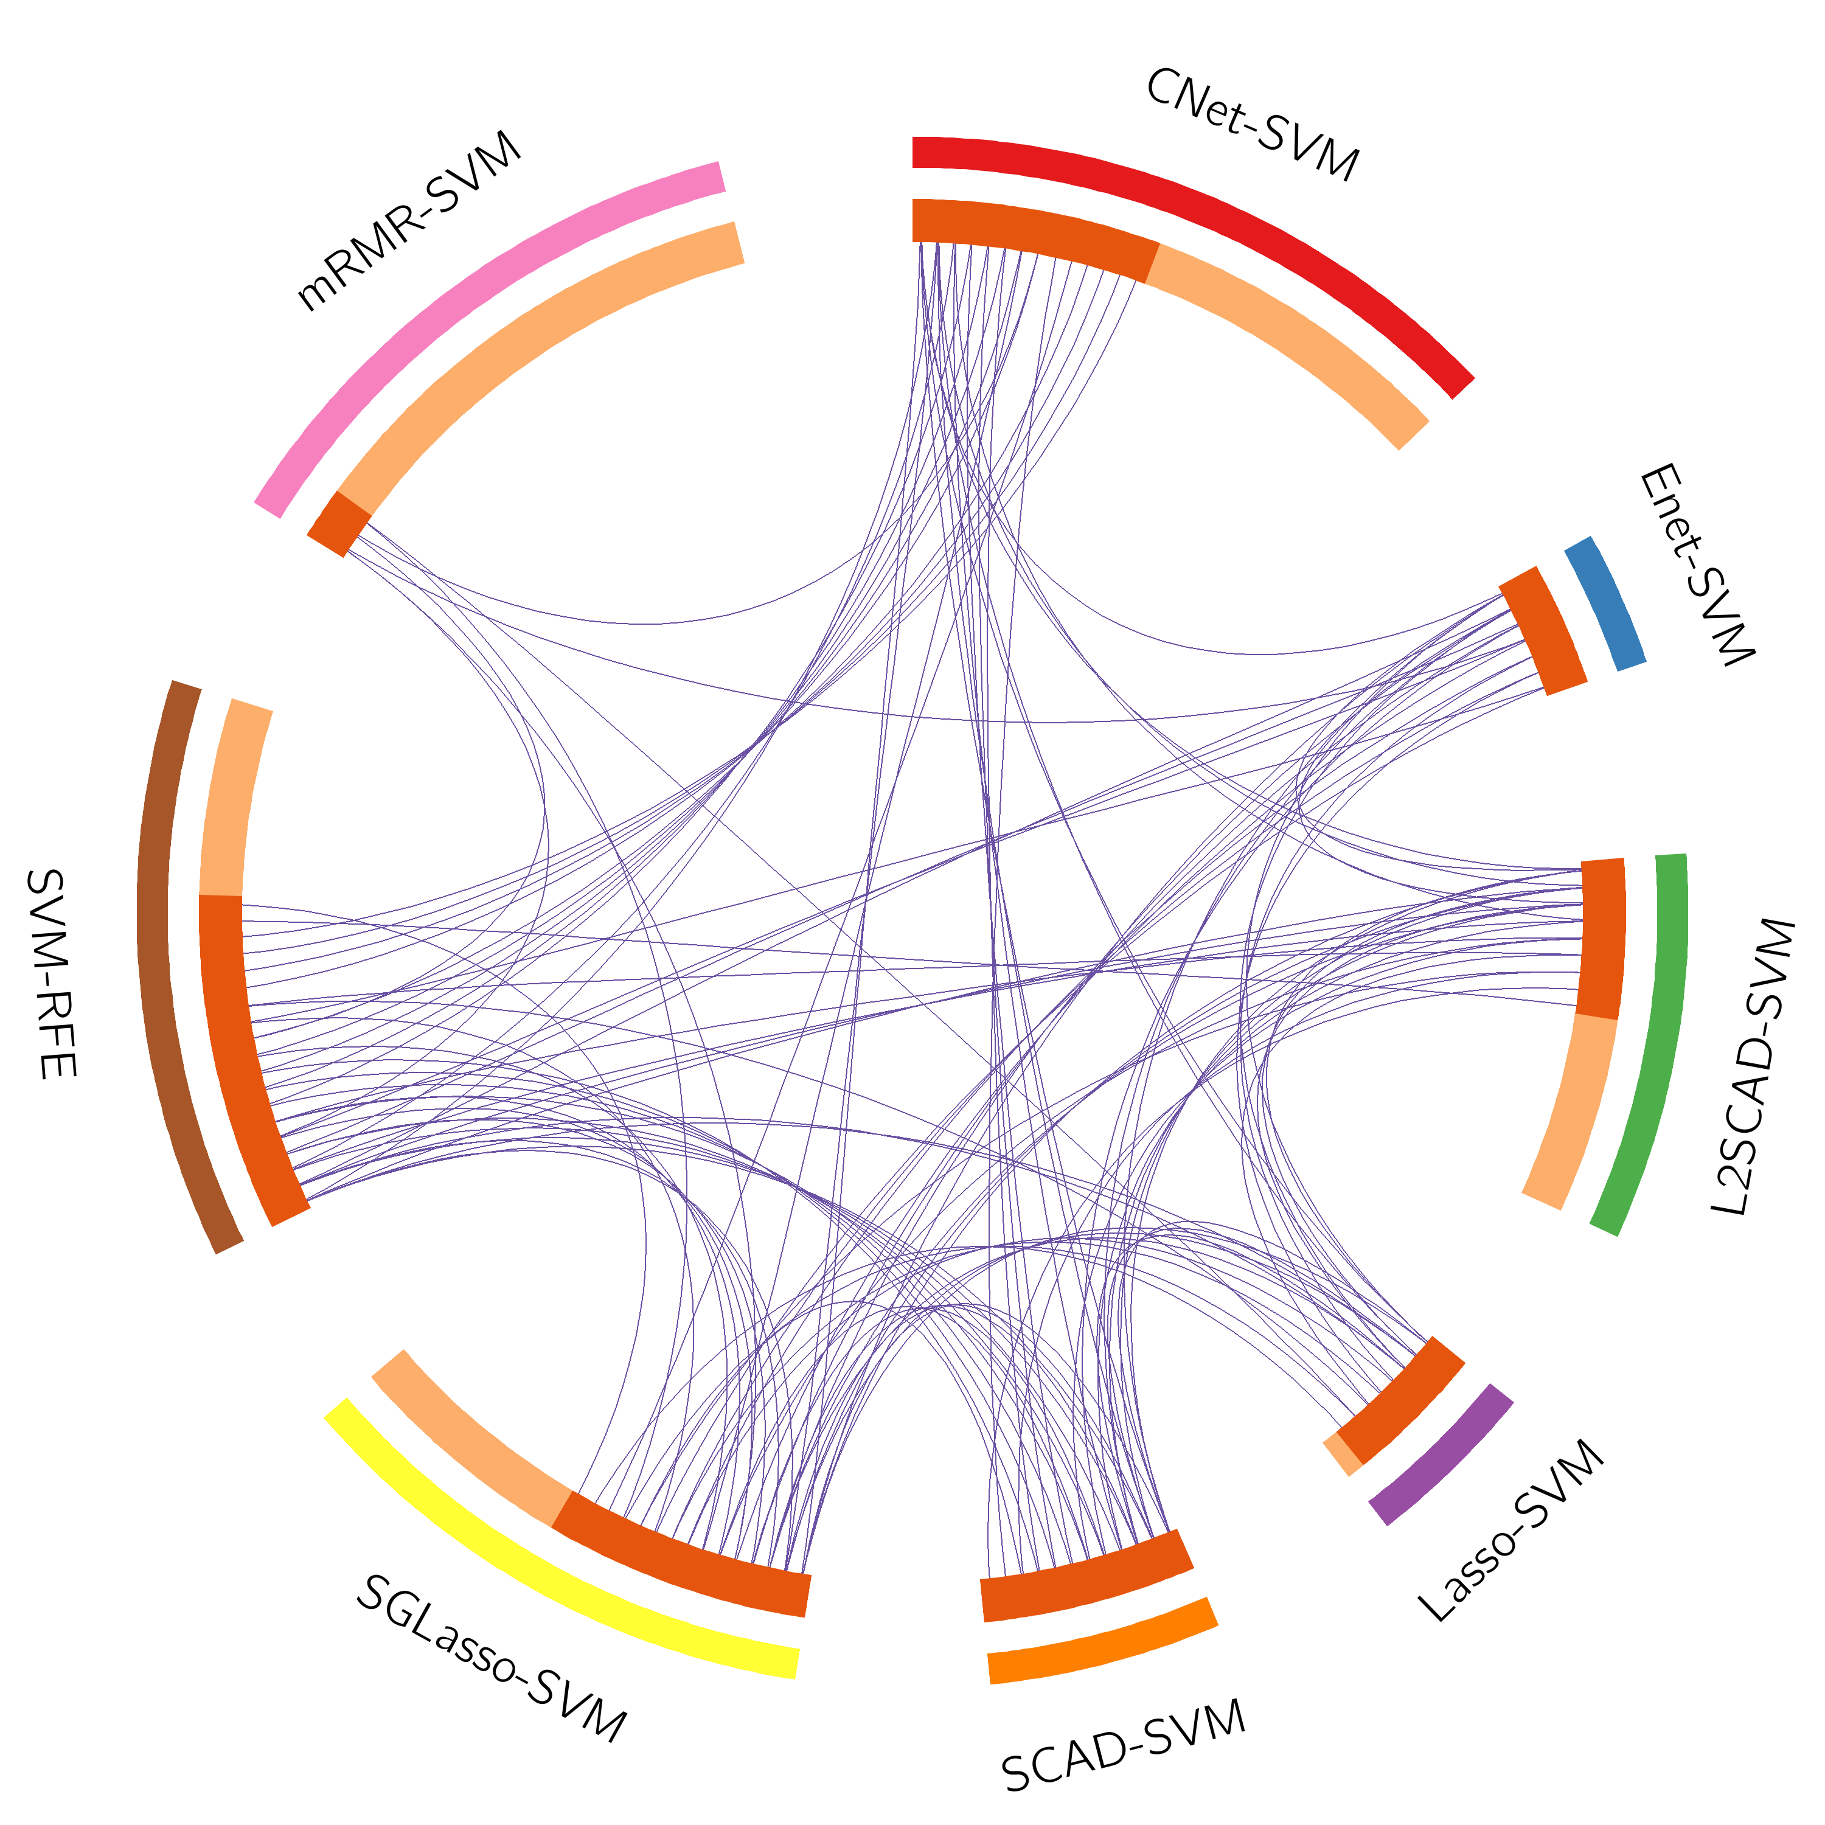
Gene Overlap Analysis
Notes:
The Circos plot shows how genes from the input gene lists overlap.
On the outside, each arc represents the identity of each gene list, using the same color code as the color used for table rows in slide #2.
On the inside, each arc represents a gene list, where each gene member of that list is assigned a spot on the arc. Dark orange color represents the genes that are shared by multiple lists and light orange color represents genes that are unique to that gene list.
Purple lines link the same gene that are shared by multiple gene lists (notice a gene that appears in two gene lists will be mapped once onto each gene list, therefore, the two positions are purple linked).
The greater the number of purple links and the longer the dark orange arcs implies greater overlap among the input gene lists.

Slide 4
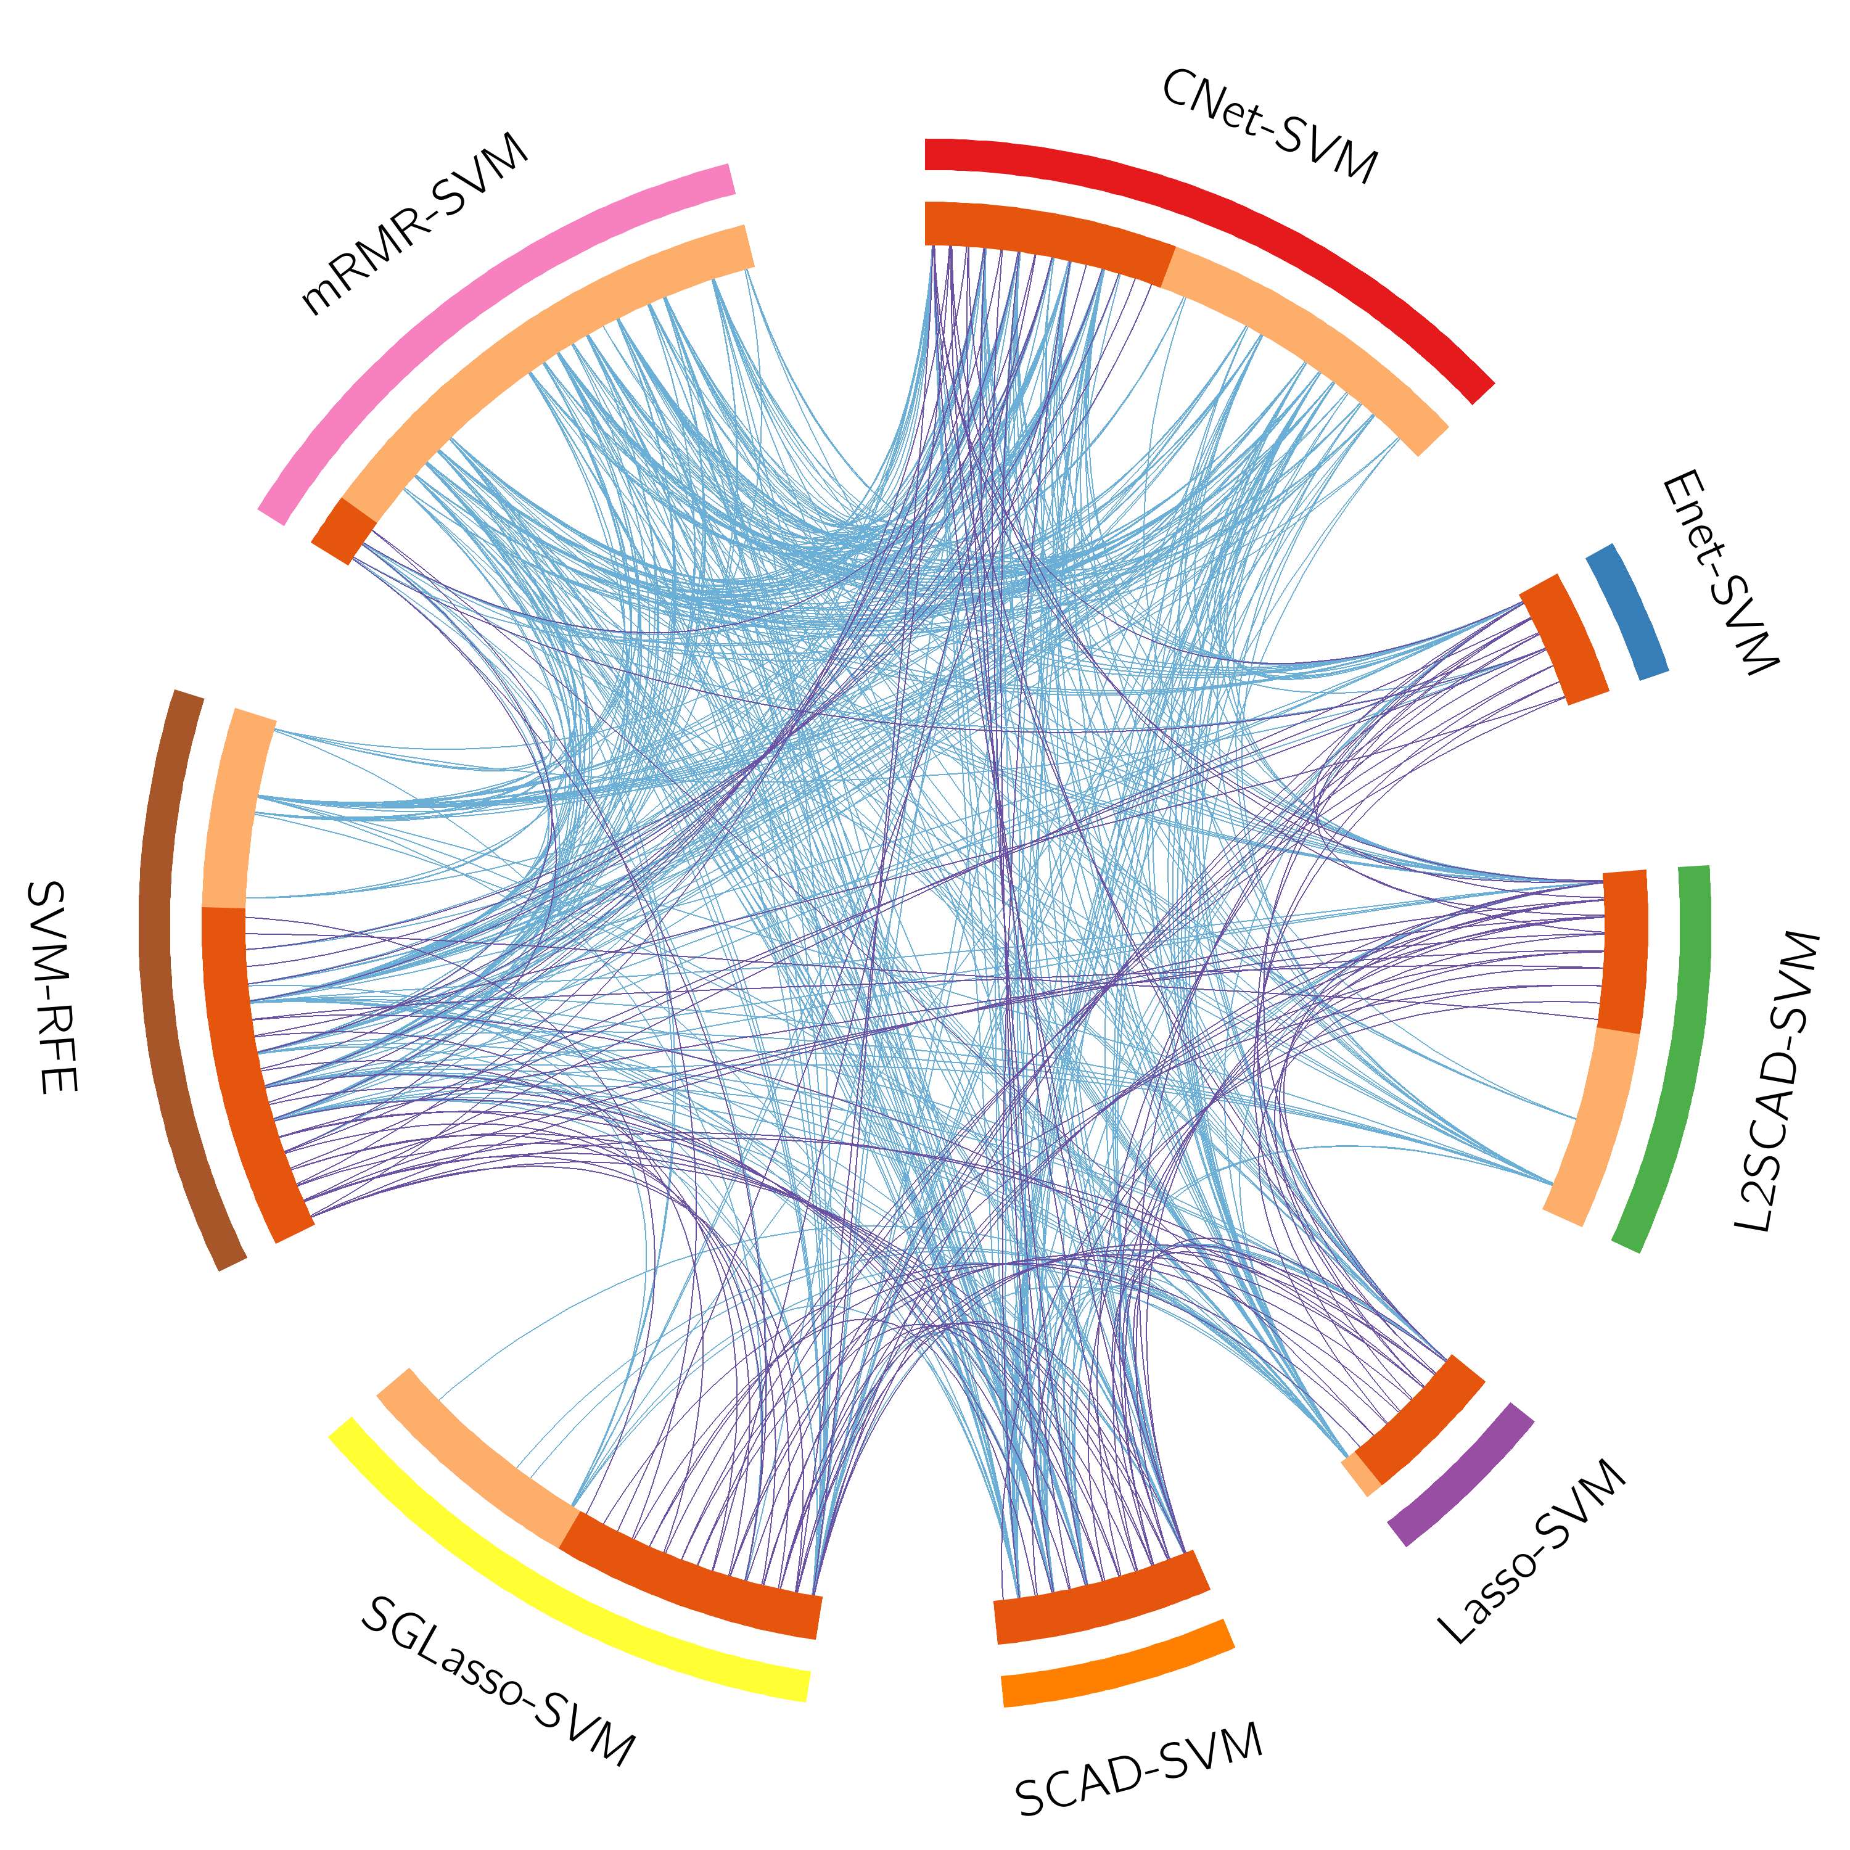
Gene Overlap Analysis Expanded via Shared Enriched Ontologies
Notes:
The Circos plot shows how genes from the input gene lists overlap.
On the outside, each arc represents the identity of each gene list, using the same color code as the color used for table rows in slide #2.
On the inside, each arc represents a gene list, where each gene member of that list is assigned a spot on the arc. Dark orange color represents the genes that are shared by multiple lists and light orange color represents genes that are unique to that gene list.
Purple lines link the same gene that are shared by multiple gene lists (notice a gene that appears in two gene lists will be mapped once onto each gene list, therefore, the two positions are purple linked). Blue lines link the genes, although different, fall under the same ontology term (the term has to statistically significantly enriched and with size no larger than 100).
The greater the number of purple links and the longer the dark orange arcs implies greater overlap among the input gene lists. Blue links indicate the amount of functional overlap among the input gene lists. It is common in meta-analysis that we observe little directly overlap among studies, due to the variations in the biological assays used. However, we tend to see a lot more functional overlap, as these studies probably pick up different subset of gene members of the same biological processes.

Slide 5
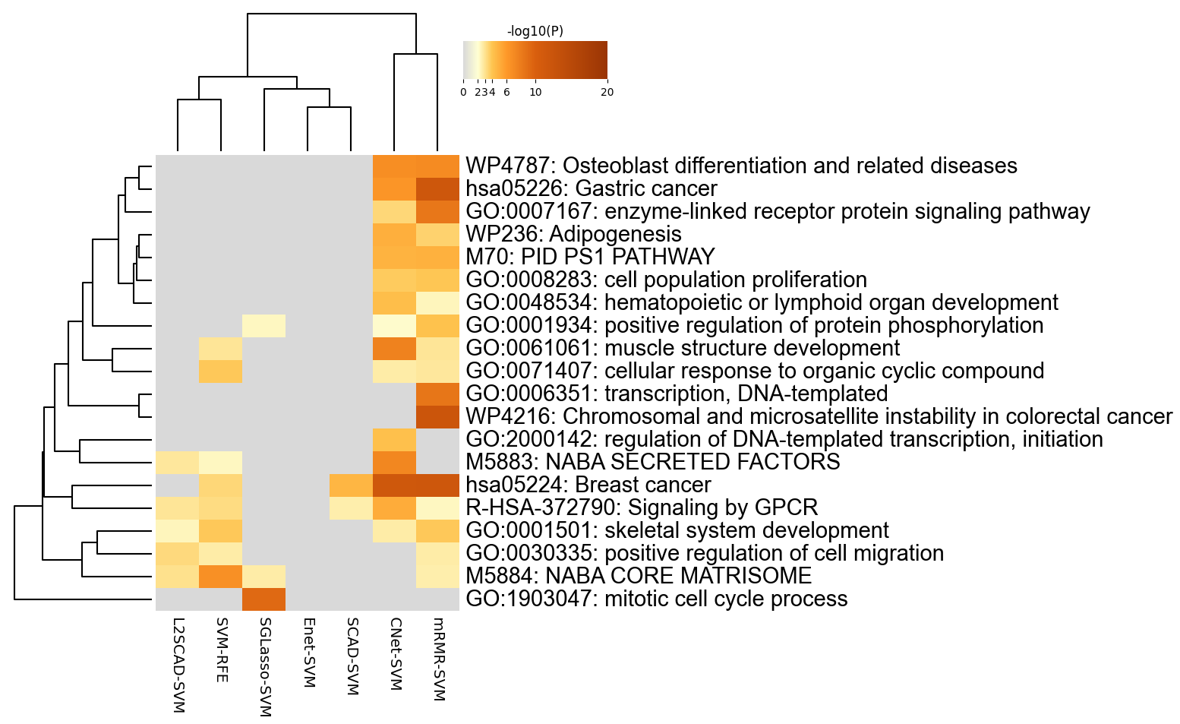
Enriched Ontology Clusters Across Studies
Notes:
We first identified all statistically enriched terms (can be GO/KEGG terms, canonical pathways, hall mark gene sets, etc., based on the default choices under Express Analysis or your choice during Custom Analysis), accumulative hypergeometric p-values and enrichment factors were calculated and used for filtering. Remaining significant terms were then hierarchically clustered into a tree based on Kappa-statistical similarities among their gene memberships (similar to what is used in NCI DAVID site). Then 0.3 kappa score was applied as the threshold to cast the tree into term clusters. The terms within each cluster are exported in the Excel spreadsheet named “Enrichment Analysis”.
We selected the term with the best p-value within each cluster as its representative term and display them in a dendrogram. The heatmap cells are colored by their p-values, white cells indicate the lack of enrichment for that term in the corresponding gene list. We also export files behind this heatmap (.cdt, .gtr, .atr, and .jtv files), so that one can visualize it interactively using JTreeView program (http://sourceforge.net/projects/jtreeview/). The PDF version of the graph can be found in the zip package.
If you want to view the complete list of enriched terms, please download the .zip file and check Enrichment_GO/GO_AllLists.csv.
Note: gene lists containing more than 3000 genes are not analyzed. Please use a more stringent hit calling criterion, as you most likely have retained too many genes.

Slide 6
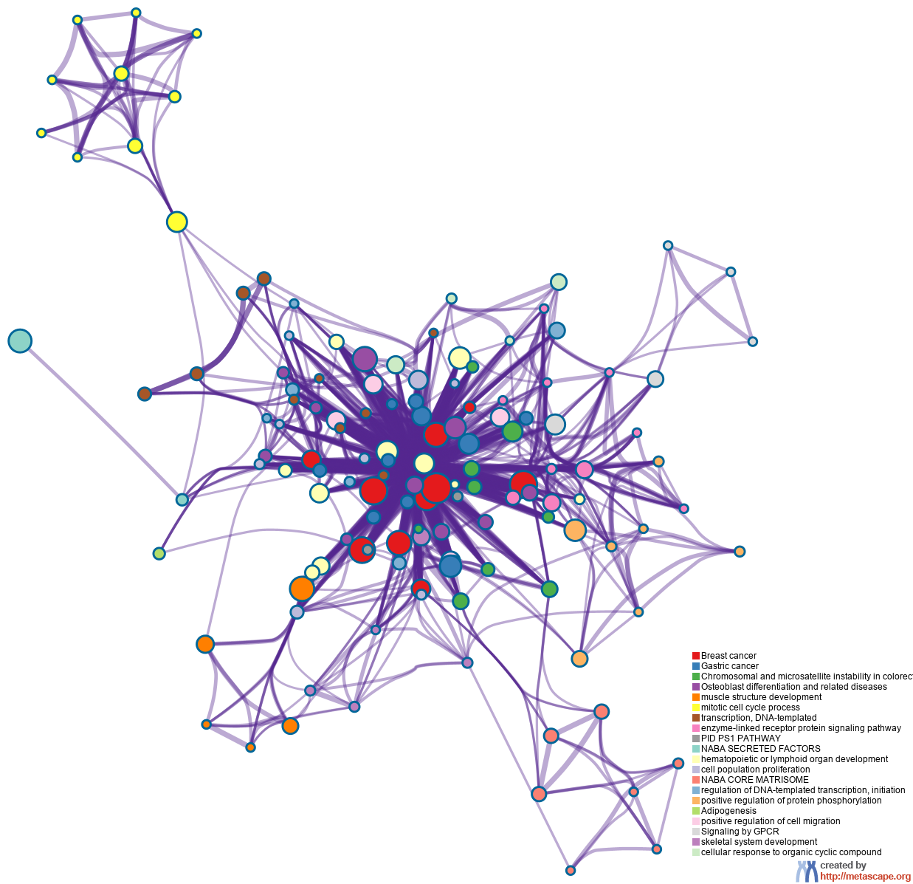
Enriched Ontology Clusters Colored by Cluster ID
Notes:
We selected a subset of representative terms from the full cluster and converted them into a network layout. More specifically, each term is represented by a circle node, where its size is proportional to the number of input genes fall under that term, and its color represent its cluster identity (i.e., nodes of the same color belong to the same cluster). Terms with a similarity score > 0.3 are linked by an edge (the thickness of the edge represents the similarity score). The network is visualized with Cytoscape with “force-directed” layout and with edge bundled for clarity. One term from each cluster is selected to have its term description shown as label.

Slide 7
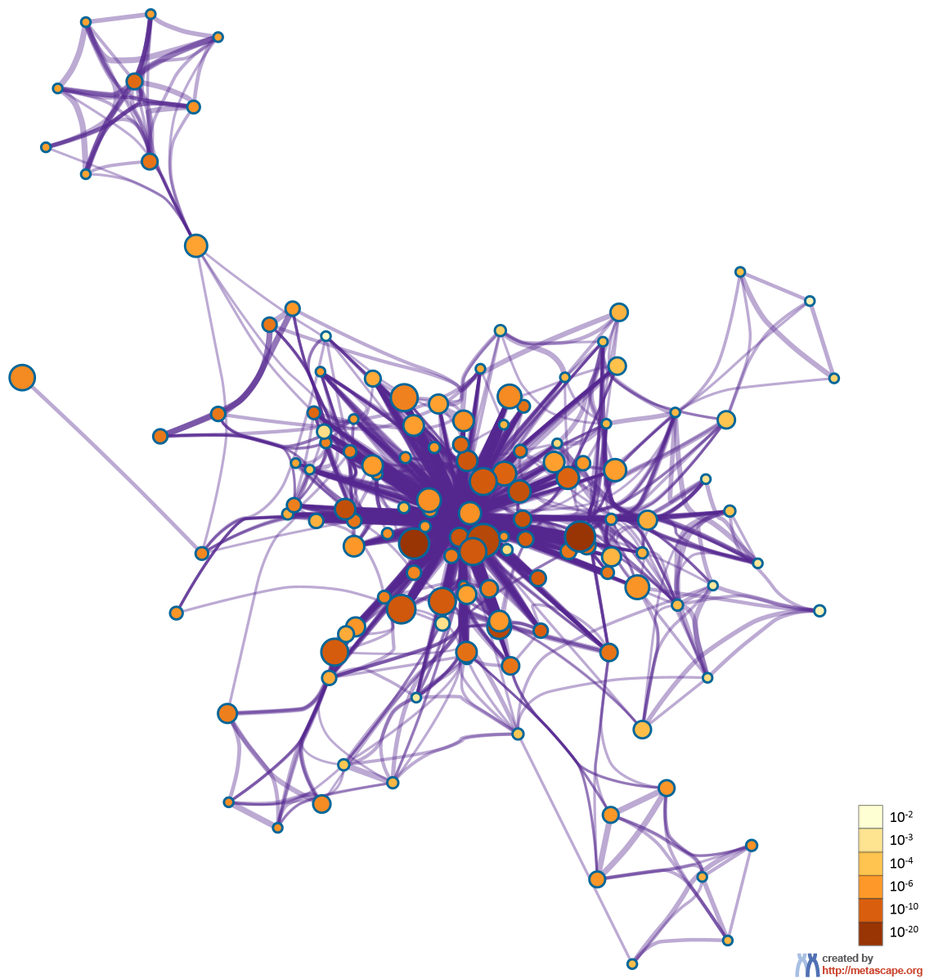
Enriched Ontology Clusters Colored by p-Value
Notes:
The same enrichment network has its nodes colored by p-value, as shown in the legend. The dark the color, the more statistically significant the node is (see legend for p-value ranges).

Slide 8
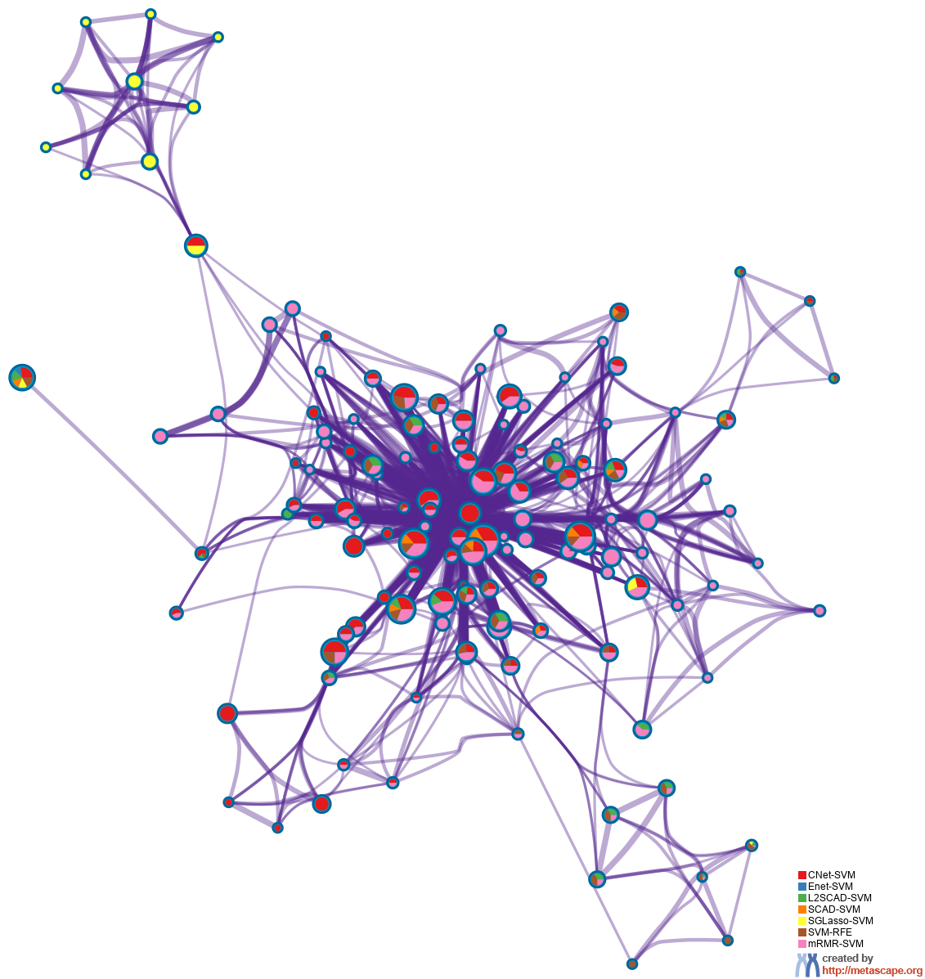
Enriched Ontology Clusters Pied by Gene Counts Across Studies
Notes:
The same enrichment network has its nodes displayed as pies. Each pie sector is proportional to the number of hits originated from a gene list.
Color code for pie sector represents a gene list and is consistent with the colors used for table rows in slide #2.

Slide 9
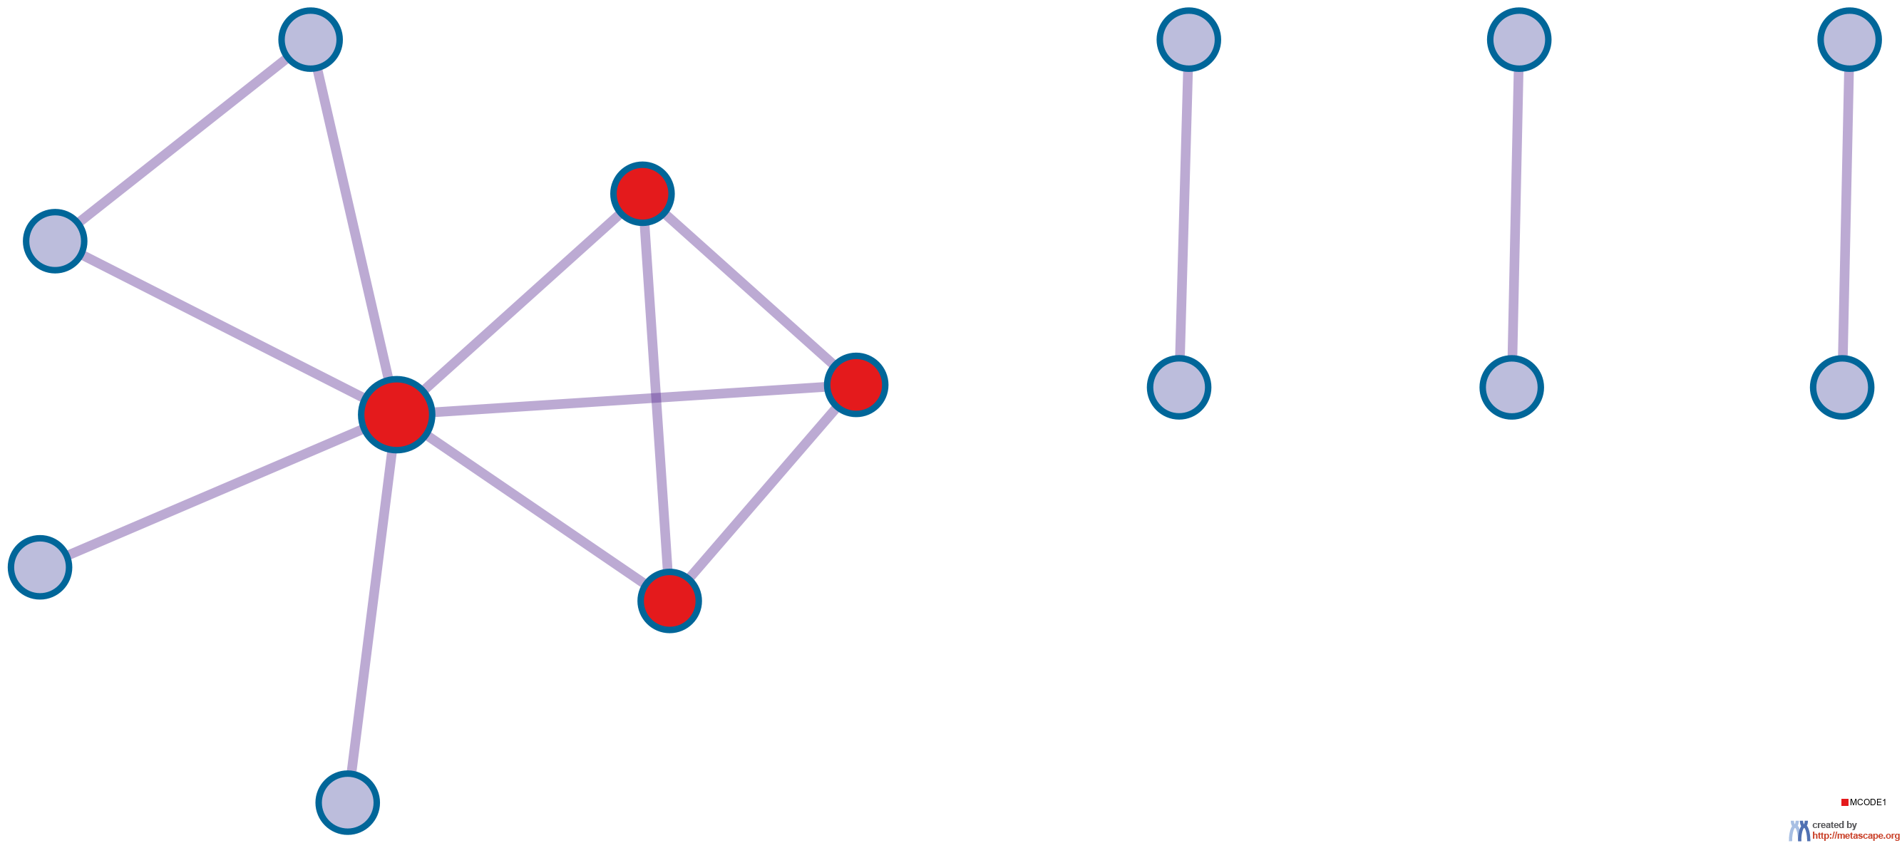
Protein-protein Interaction Network
Gene List: CNet-SVM
Notes:
All protein-protein interactions among input genes were extracted from PPI data source and formed a PPI network.
GO enrichment analysis was applied to the network to extract “biological meanings”.

Slide 10
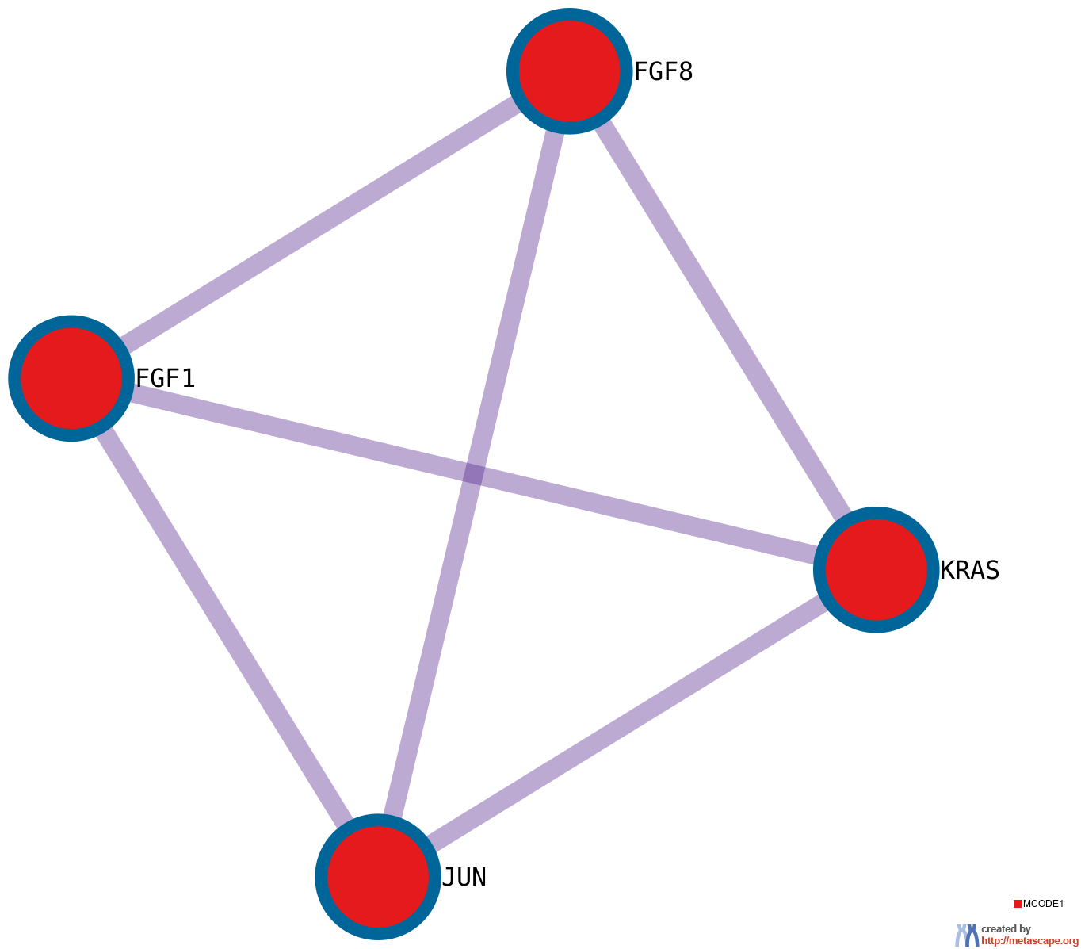
PPI MCODE Components
Gene List: CNet-SVM
Notes:
MCODE algorithm was then applied to this network to identify neighborhoods where proteins are densely connected. Each MCODE network is assigned a unique color.

Slide 11
Biological Interpretation PPI Network & MCODE Components
Gene List: CNet-SVM
Network | Annotation
CNet-SVM | WP3931|Embryonic stem cell pluripotency pathways|-11.0;hsa05224|Breast cancer|-10.5;WP4262|Breast cancer pathway|-10.3
CNet-SVM_MCODE_ALL | hsa05224|Breast cancer|-9.3;WP4262|Breast cancer pathway|-9.2;R-HSA-5654704|SHC-mediated cascade:FGFR3|-9.1
CNet-SVM_SUB1_MCODE_1 | hsa05224|Breast cancer|-9.3;WP4262|Breast cancer pathway|-9.2;R-HSA-5654704|SHC-mediated cascade:FGFR3|-9.1
Notes:
GO enrichment analysis was applied to each MCODE network to extract “biological meanings” from the network component, where top three best p-value terms were retained.

Slide 12

Protein-protein Interaction Network
Gene List: L2SCAD-SVM

Slide 13
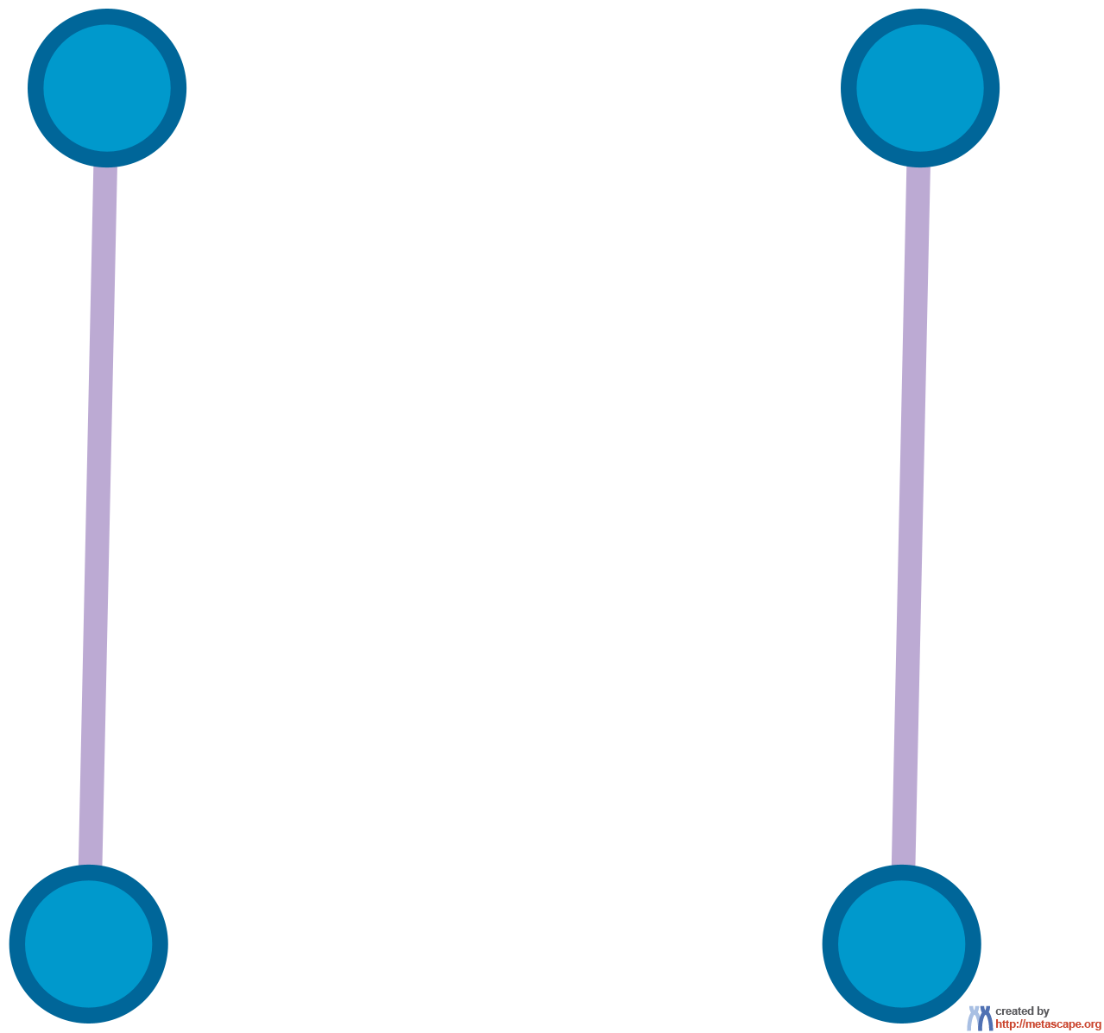
Protein-protein Interaction Network
Gene List: SCAD-SVM

Slide 14
Biological Interpretation PPI Network & MCODE Components
Gene List: SCAD-SVM
Network | Annotation
SCAD-SVM | R-HSA-388396|GPCR downstream signalling|-4.4;R-HSA-372790|Signaling by GPCR|-4.3

Slide 15
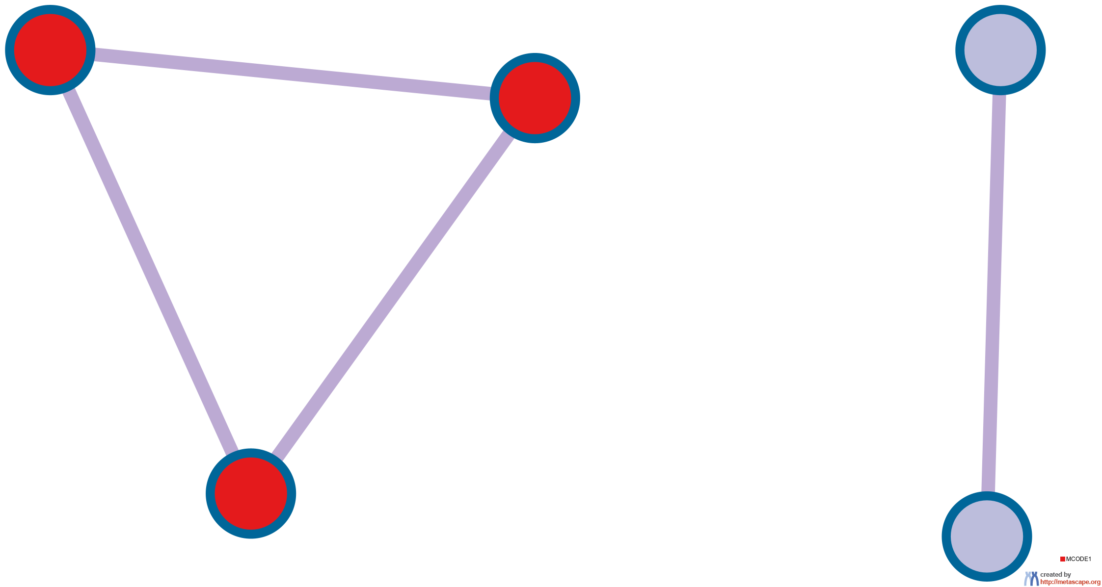
Protein-protein Interaction Network
Gene List: SGLasso-SVM

Slide 16
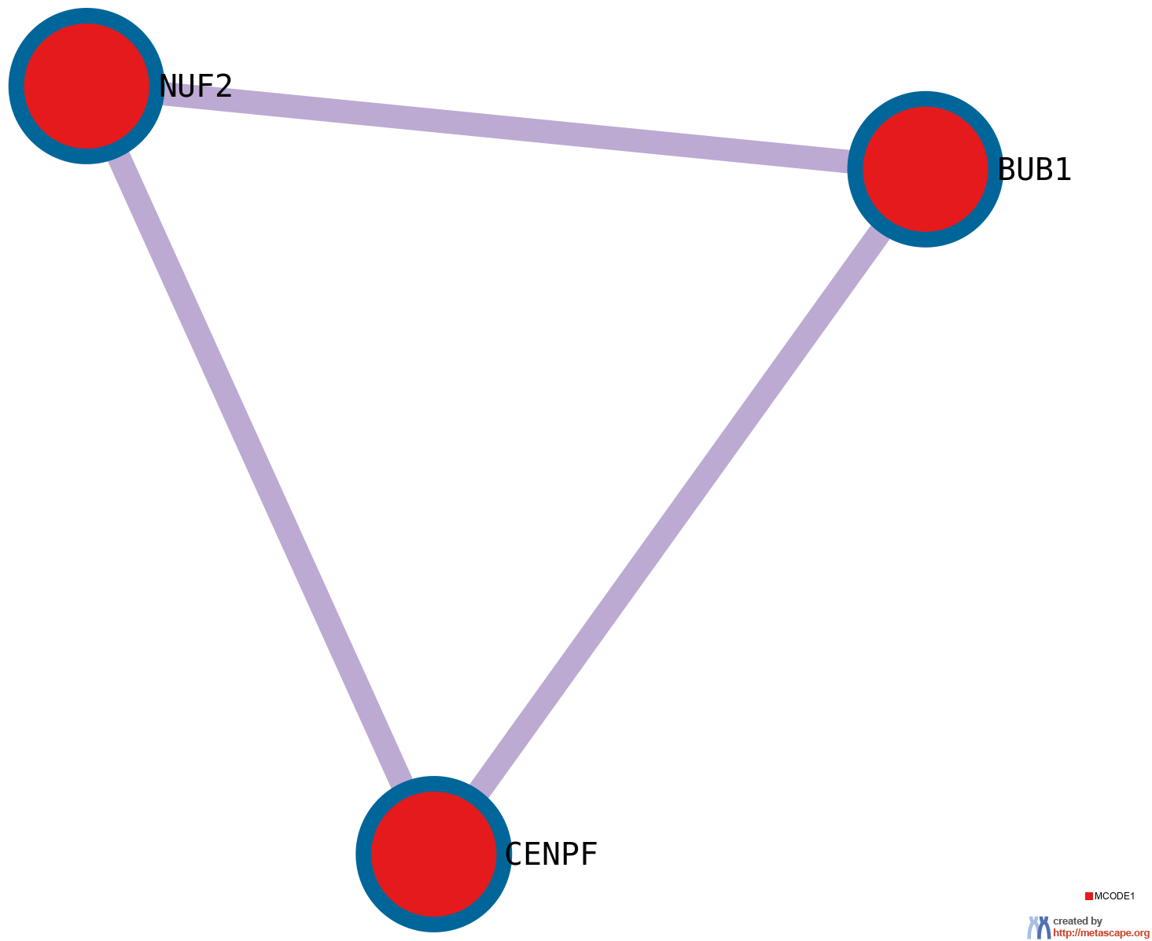
PPI MCODE Components
Gene List: SGLasso-SVM

Slide 17
Biological Interpretation PPI Network & MCODE Components
Gene List: SGLasso-SVM
Network | Annotation
SGLasso-SVM | GO:0007088|regulation of mitotic nuclear division|-9.0;GO:0051301|cell division|-8.9;GO:1903047|mitotic cell cycle process|-8.9
SGLasso-SVM_MCODE_ALL | GO:0071174|mitotic spindle checkpoint signaling|-9.1;GO:0071173|spindle assembly checkpoint signaling|-9.1;GO:0007094|mitotic spindle assembly checkpoint signaling|-9.1
SGLasso-SVM_SUB1_MCODE_1 | GO:0007094|mitotic spindle assembly checkpoint signaling|-9.1;GO:0071174|mitotic spindle checkpoint signaling|-9.1;GO:0071173|spindle assembly checkpoint signaling|-9.1

Slide 18
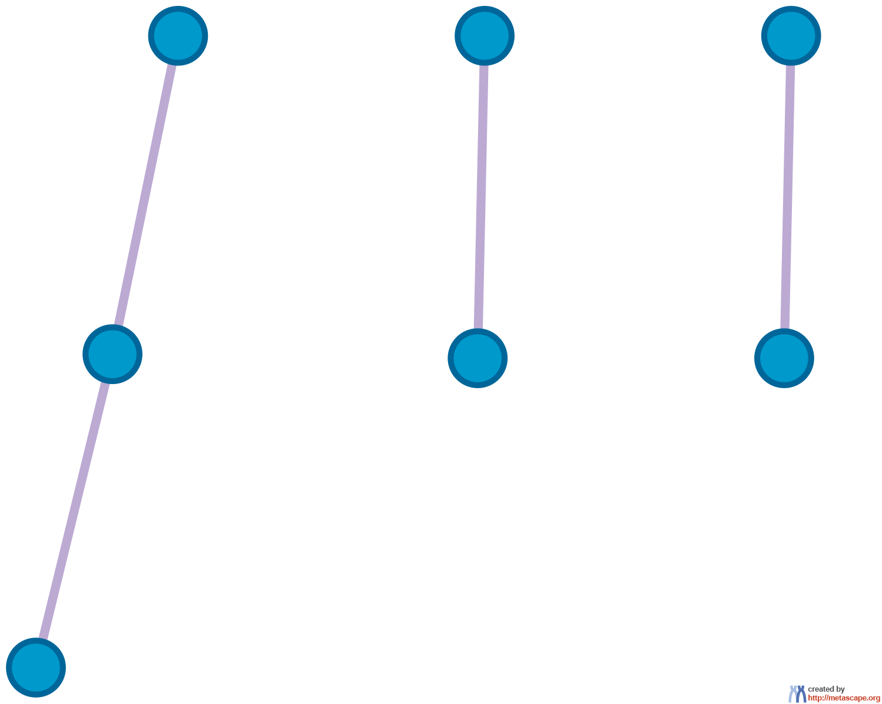
Protein-protein Interaction Network
Gene List: SVM-RFE

Slide 19
Biological Interpretation PPI Network & MCODE Components
Gene List: SVM-RFE
Network | Annotation
SVM-RFE | WP3932|Focal adhesion: PI3K-Akt-mTOR-signaling pathway|-4.4;WP4172|PI3K-Akt signaling pathway|-4.3;hsa04151|PI3K-Akt signaling pathway|-4.3

Slide 20
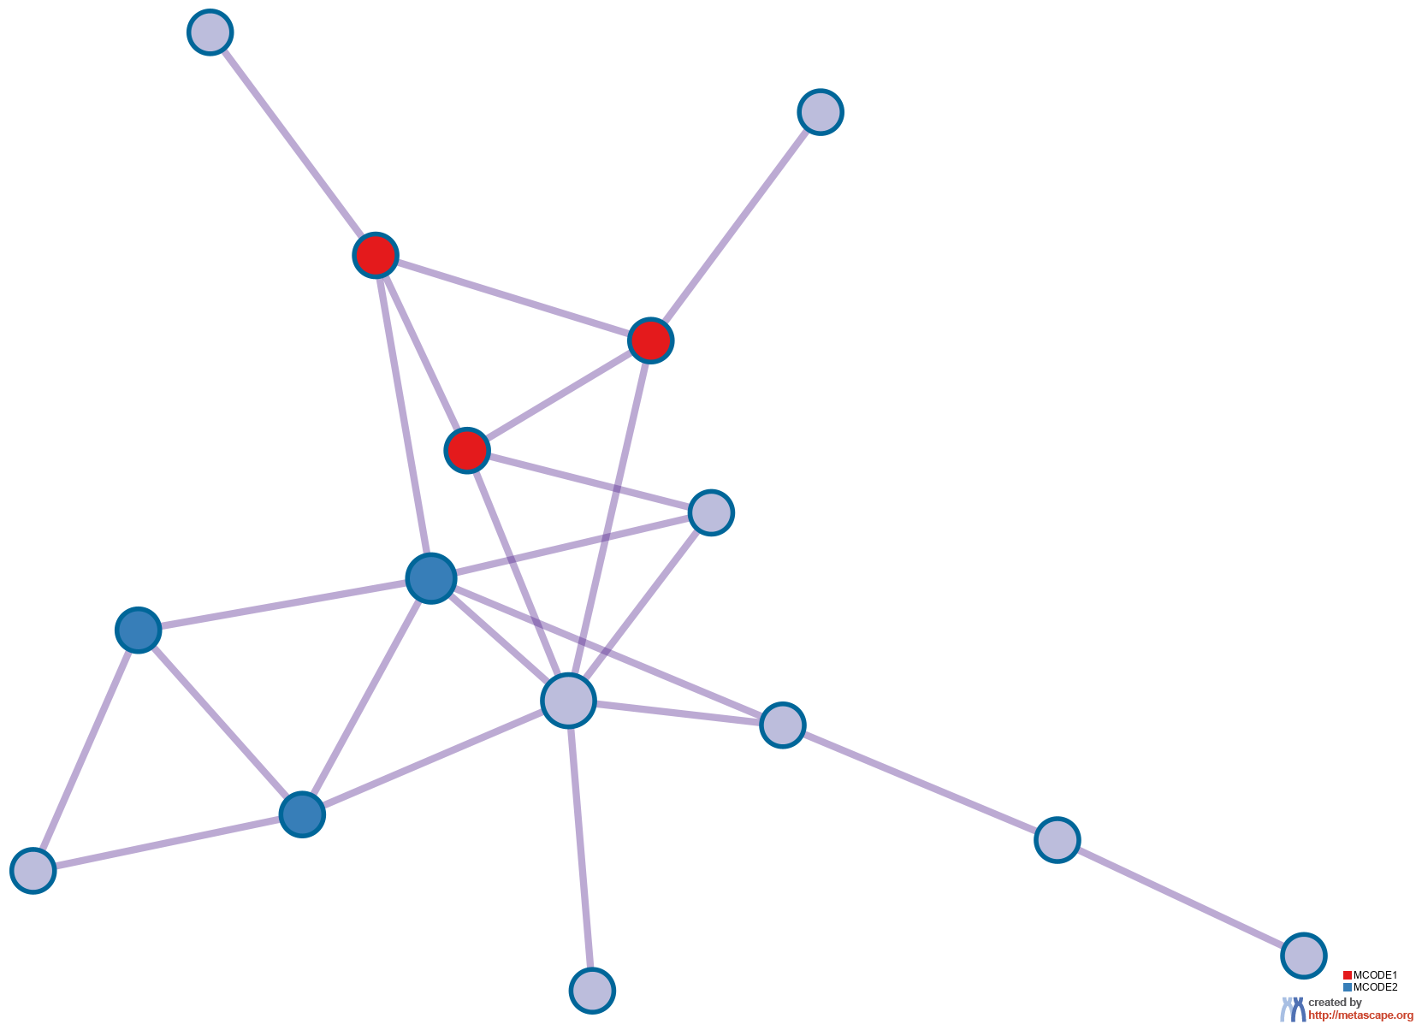
Protein-protein Interaction Network
Gene List: mRMR-SVM

Slide 21
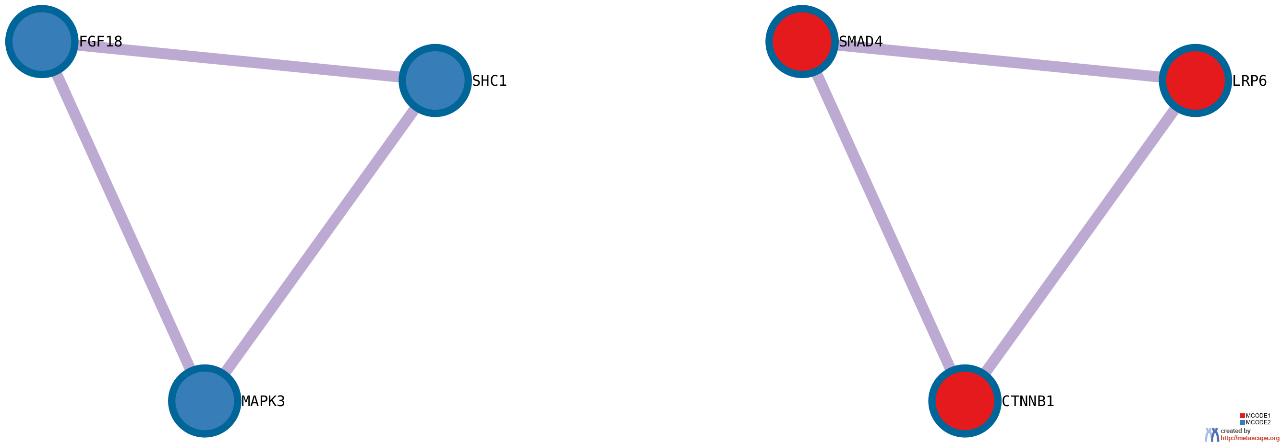
PPI MCODE Components
Gene List: mRMR-SVM

Slide 22
Biological Interpretation PPI Network & MCODE Components
Gene List: mRMR-SVM
Network | Annotation
mRMR-SVM | R-HSA-5663202|Diseases of signal transduction by growth factor receptors and second messengers|-13.0;hsa05224|Breast cancer|-12.5;hsa05226|Gastric cancer|-12.4
mRMR-SVM_MCODE_ALL | hsa05226|Gastric cancer|-13.9;WP4787|Osteoblast differentiation and related diseases|-11.3;R-HSA-5663202|Diseases of signal transduction by growth factor receptors and second messengers|-11.1
mRMR-SVM_SUB1_MCODE_1 | GO:0001837|epithelial to mesenchymal transition|-7.8;WP3931|Embryonic stem cell pluripotency pathways|-7.2;WP4787|Osteoblast differentiation and related diseases|-7.2
mRMR-SVM_SUB1_MCODE_2 | R-HSA-5654741|Signaling by FGFR3|-8.7;R-HSA-5654743|Signaling by FGFR4|-8.6;R-HSA-5654736|Signaling by FGFR1|-8.4

Slide 23
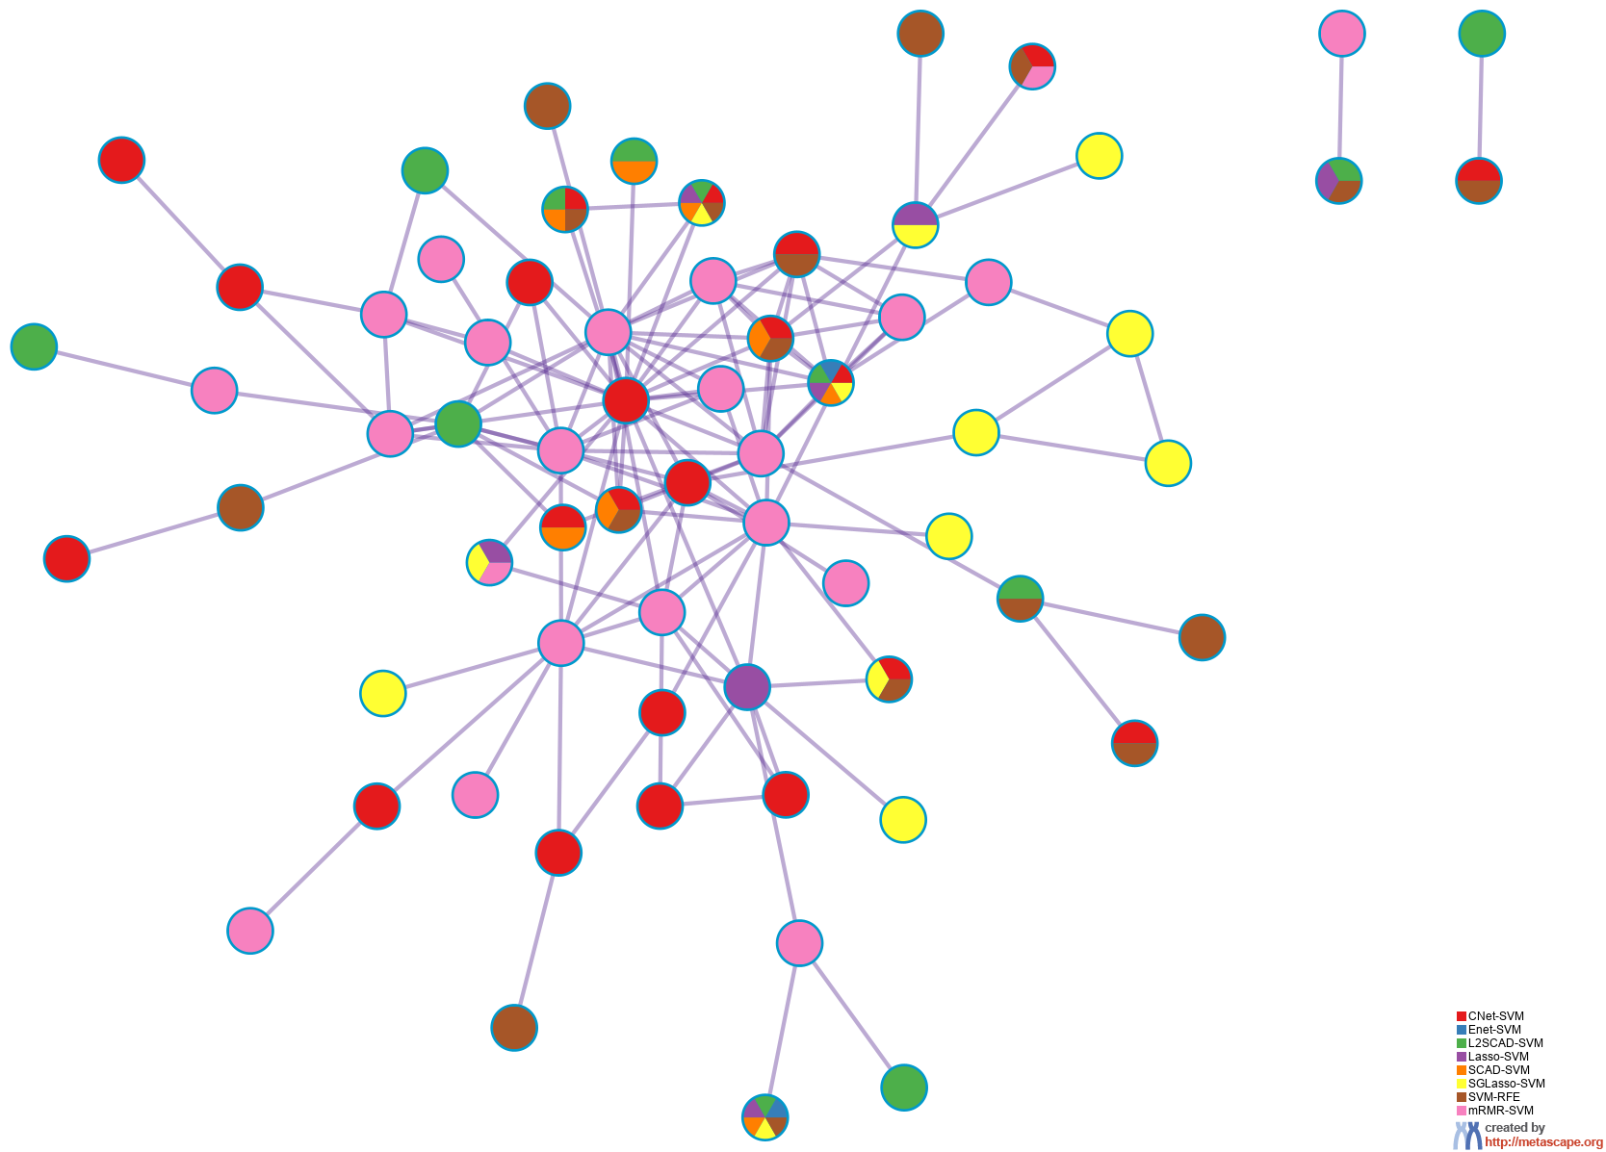
PPI Network for Lists Merged Pied by Gene Origin in Studies
Notes:
All input gene lists were also merged into one list and resulted in a PPI network.
Network nodes are displayed as pies. Color code for pie sector represents a gene list and is consistent with the colors used for table rows in slide #2.

Slide 24
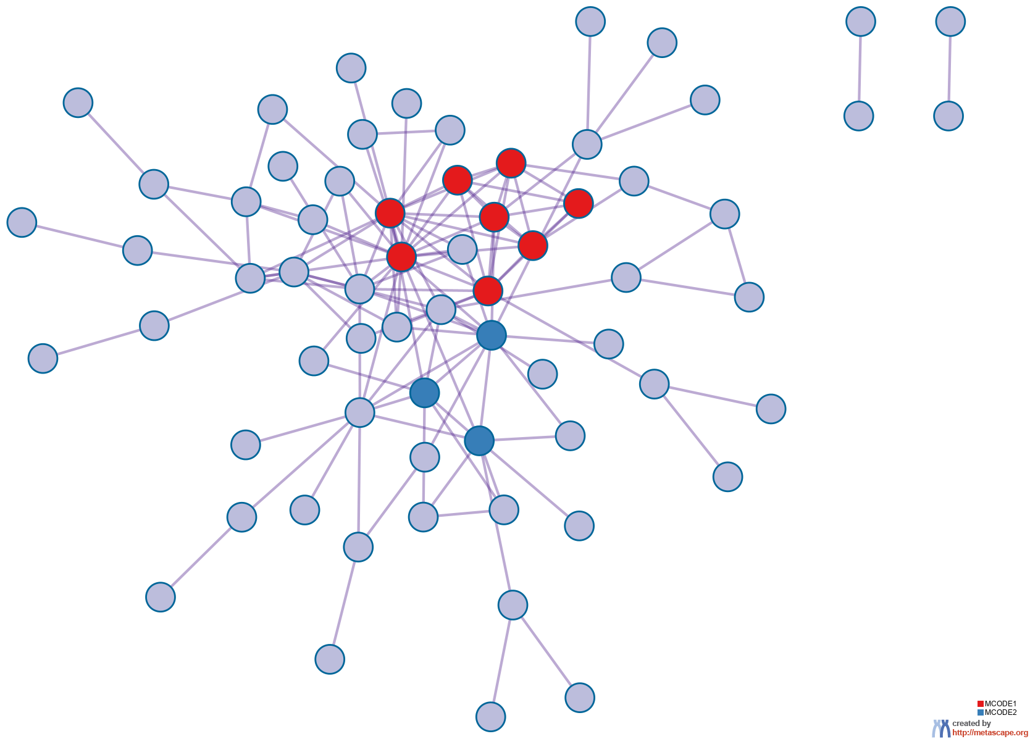
PPI Network for Lists Merged Colored by MCODE ID
Notes:
All input gene lists were also merged. Each MCODE network is assigned a unique color.

Slide 25
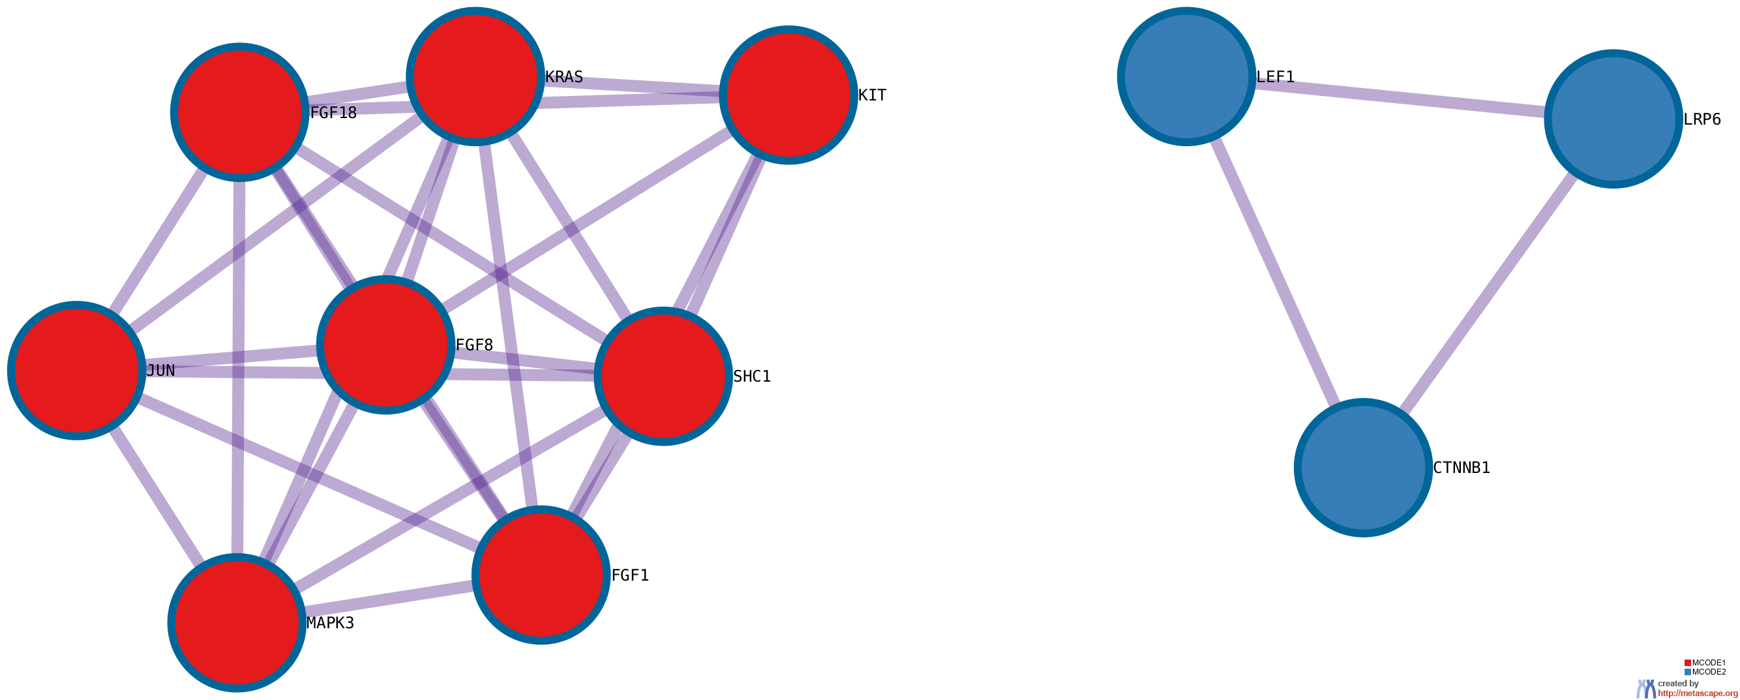
Protein-protein Interaction Network
Notes:
MCODE components were identified from the merged network. Each MCODE network is assigned a unique color.

Slide 26
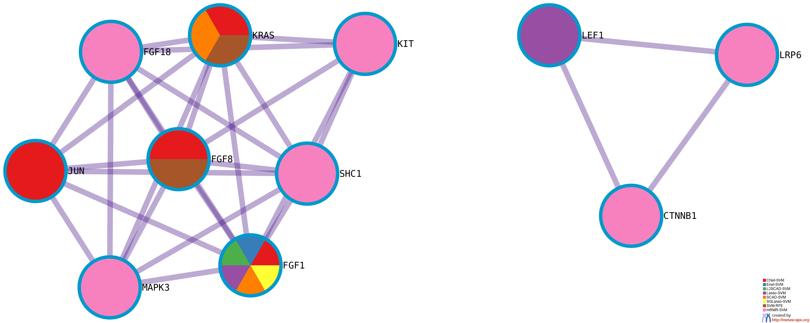
MCODE for Lists Merged Pied by Gene Origin in Studies
Notes:
MCODE algorithm was then applied to this network to identify neighborhoods where proteins are densely connected.
Network nodes are displayed as pies. Color code for pie sector represents a gene list and is consistent with the colors used for table rows in slide #2.

Slide 27
Biological Interpretation MCODE Components for Lists Merged
Network | Annotation
_FINAL | hsa05224|Breast cancer|-24.4;WP4262|Breast cancer pathway|-23.9;hsa05200|Pathways in cancer|-19.0
_FINAL_MCODE_ALL | hsa05224|Breast cancer|-25.6;WP4262|Breast cancer pathway|-25.3;hsa05226|Gastric cancer|-19.1
_FINAL_SUB1_MCODE_1 | hsa05224|Breast cancer|-18.6;WP4262|Breast cancer pathway|-18.4;R-HSA-5654741|Signaling by FGFR3|-16.0
_FINAL_SUB1_MCODE_2 | WP3658|Wnt/beta-catenin signaling pathway in leukemia|-9.2;WP363|Wnt signaling pathway|-8.3;GO:0001837|epithelial to mesenchymal transition|-7.8
Notes:
GO enrichment analysis was applied to the original PPI network and its MCODE network components to extract their “biological meanings”, where top three best p-value terms were retained.

Slide 28


metascape.org
bioinformatics for biologists
Hint: If you have multiple related gene lists, upload them in one Excel file will trigger meta analyses.
Easy, Fresh & Free
Submit gene identifiers, one click on Expression Analysis. Done!
Interpretable results: visualizations, methods, pptx, xslx, zip
Best Practices for Gene List Analyses
Rich annotations for thousands of genes at once
Pathway & process enrichment analysis
Protein-protein interaction network analysis
Overlap analysis across multiple gene lists
Common and unique pathways across multiple studies
Support key model organisms
Scalable
Docker containers available for bioinformaticians
Notes:
Thank you for using Metascape, you are welcome to past question to our public forum: https://metascape.freeforums.net, or email us with your private questions at “metascape.team at gmail.com”.

